Slide 1


ERStreamline
Team Everest
11/27/2023

Slide 2
Team Members
ØBipin Chhetri – Project Leader/FrontEnd Developer
ØNisseem Rana Magar - Project Manager/Tester
ØRaj Dhaubanjar - Documentation Specialist/Database Developer
ØRoshan Acharya – Database Architect/Frontend Developer
ØSumit Shrestha – Query Developer/BackEnd Developer

Slide 3
Technology Used
ØBackEnd - MongoDB, NodeJS, ExpressJS, Postman
ØFrontEnd – ReactJS, HTML, CSS, Tailwind
ØDiagrams – Draw.io, Lucid
ØCollaboration – GitHub, LaTeX, Teams

Slide 4
Contents
Introduction
ER Diagram and Relations
Admin Staff, Health Staff and Patient View
Data Collection and Entry
Frontend Implementation
Backend Implementation
Demo
Conclusion

Slide 5
Introduction
Problem statement: Need of real time database management system in a high stress environment like an ER for a smooth operation of a critical aspect of the community and its well-being.
Target users:
Health Care Staff
Administrative Staff
Patients

Slide 6
Requirement
Real-Time Data Access
Data Security and Compliance
Data Integrity
User Training
User Friendly

Slide 7
Proposal
ERStreamline
A specialized database management system designed to streamline the operation of an Emergency Room which enables:
Administrative staff to create and manage administrative staff, infrastructure, patient records and billing information.
Healthcare staff to create, manage and access patient visit records like diagnosis, medication, lab reports.
Patients to access their visit records, keep track of medications, lab reports and billing statement.

Slide 8
ER Diagram and Relations

Slide 9
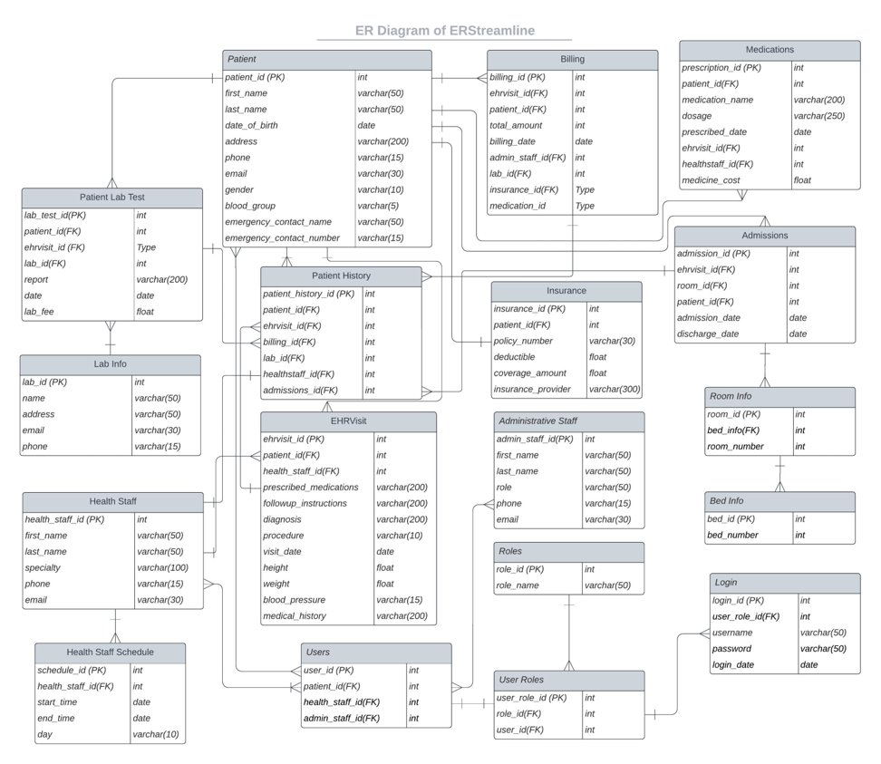
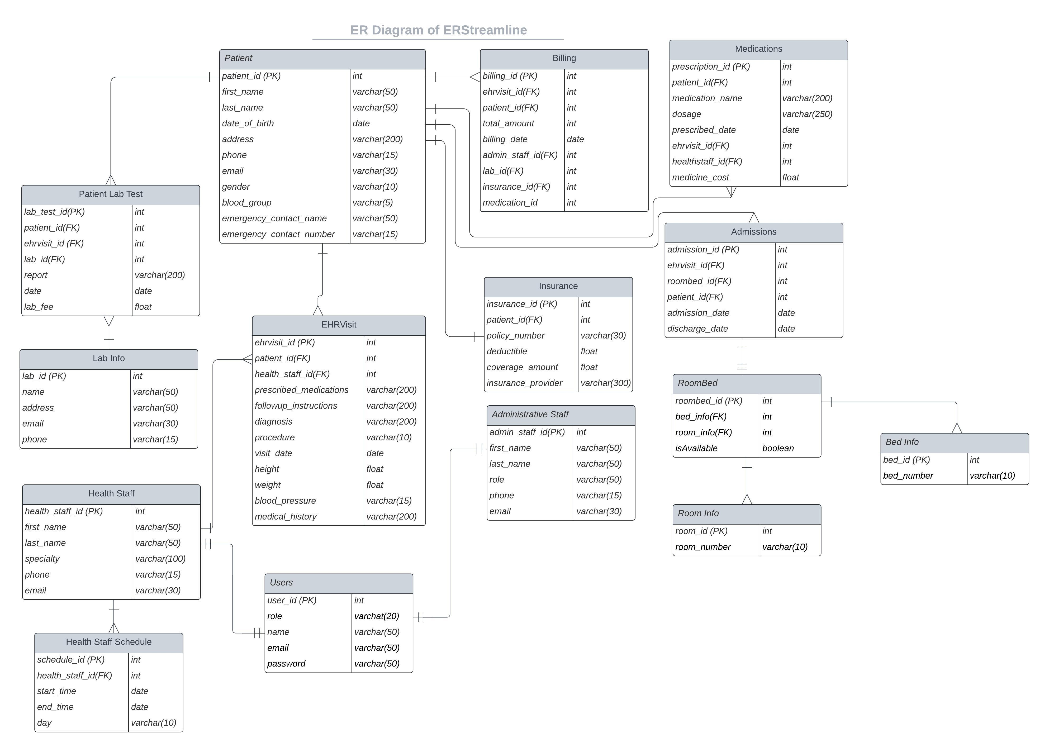
ER Diagram and Relations
BEFORE
AFTER

Slide 10
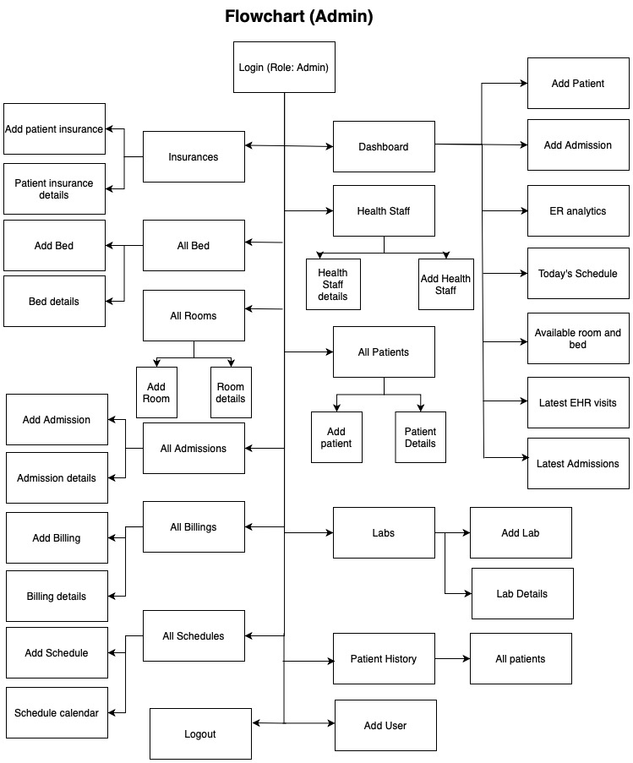
Admin Flowchart

Slide 11
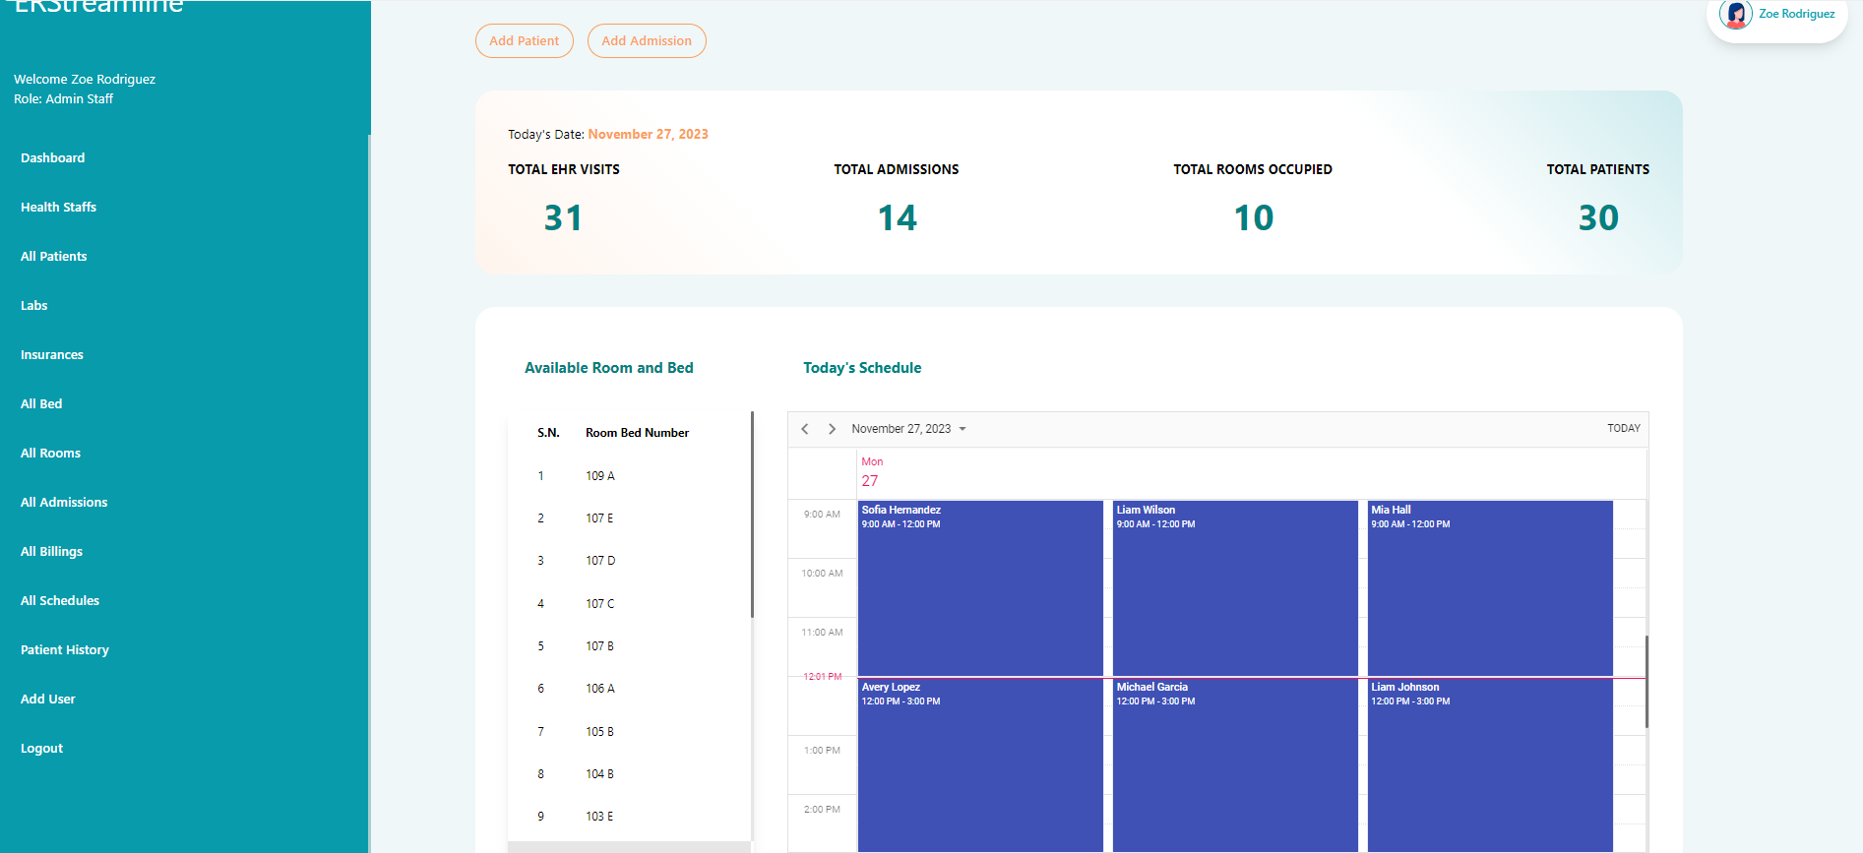
Admin Dashboard

Slide 12
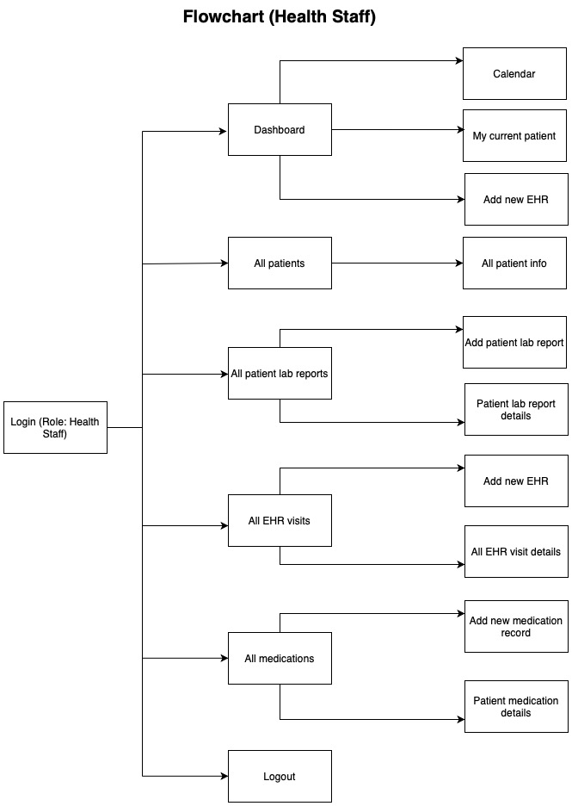
Health Staff Fowchart

Slide 13
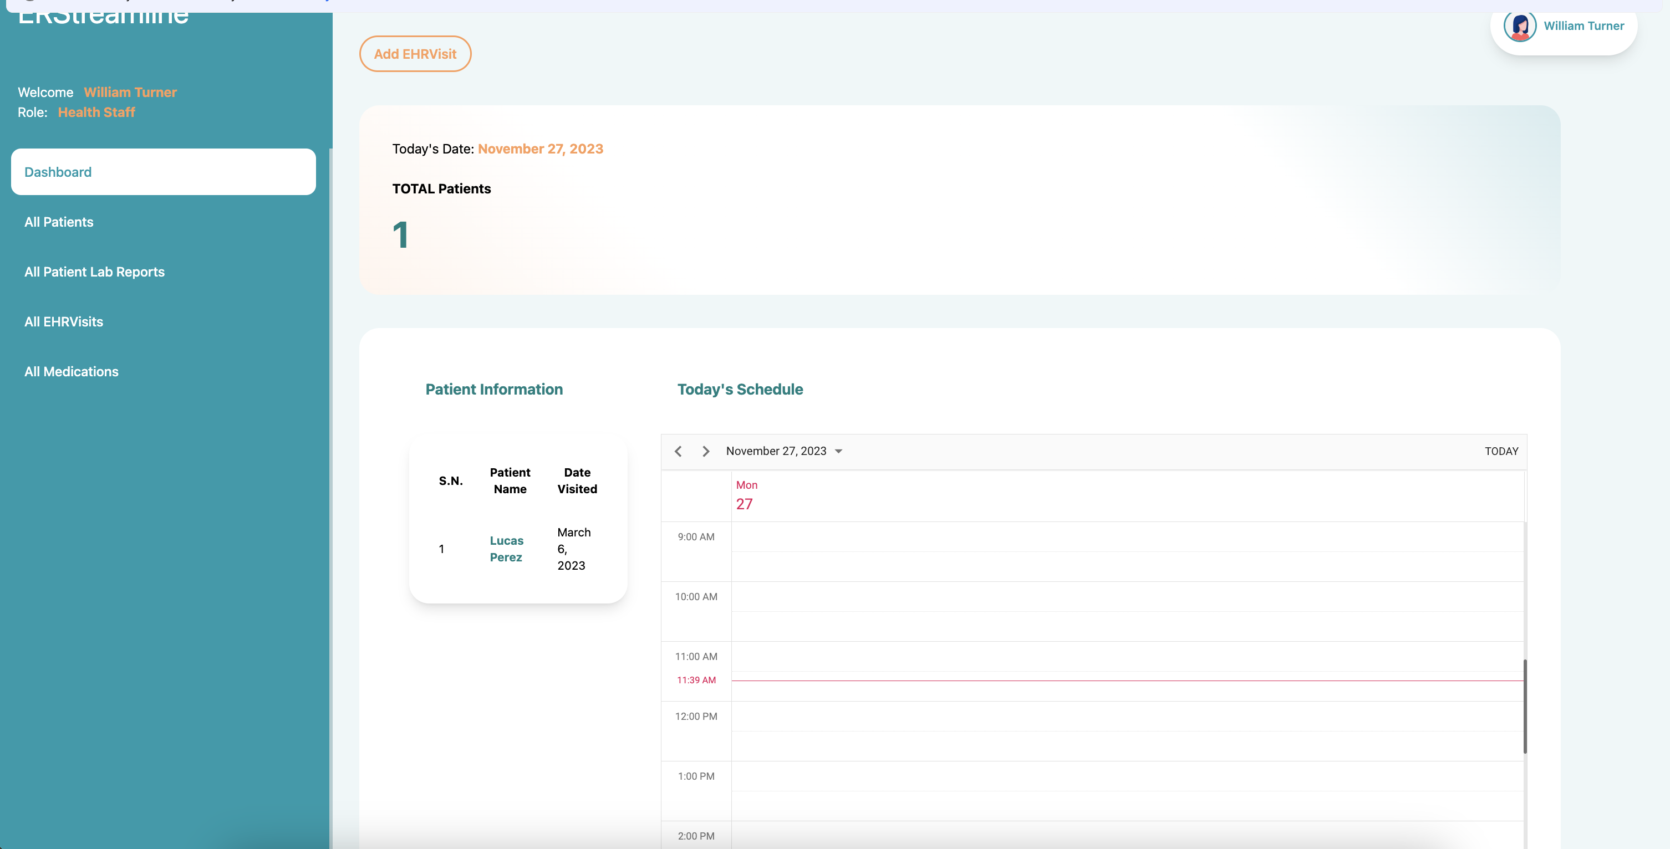
Health-Staff Dashboard

Slide 14
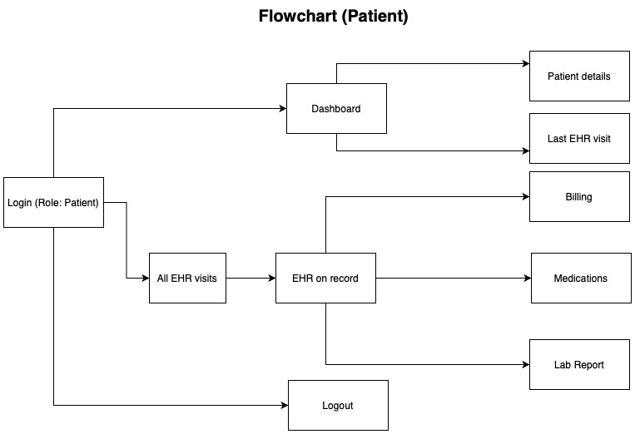
Patient Flowchart

Slide 15
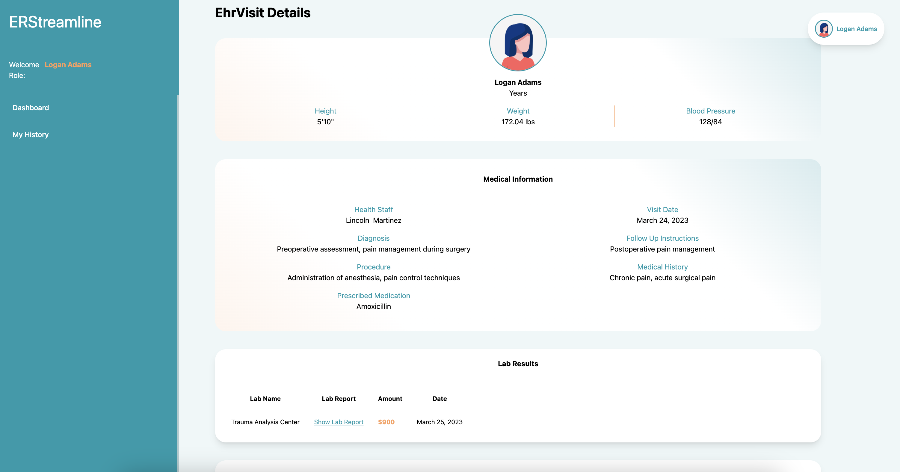
Patient Dashboard

Slide 16
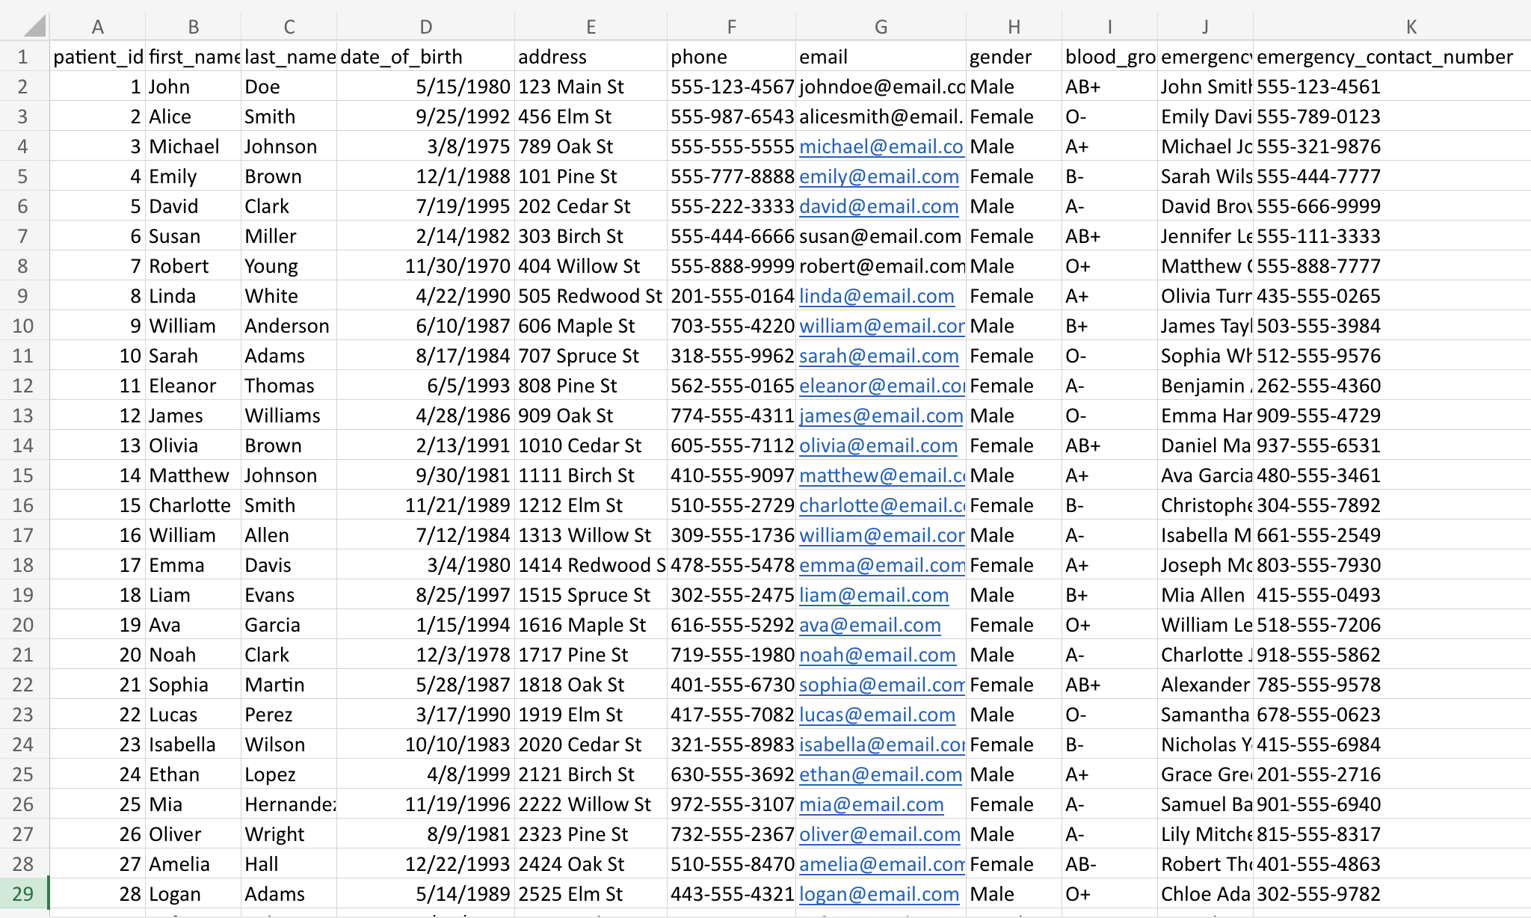
Data Collection

Slide 17
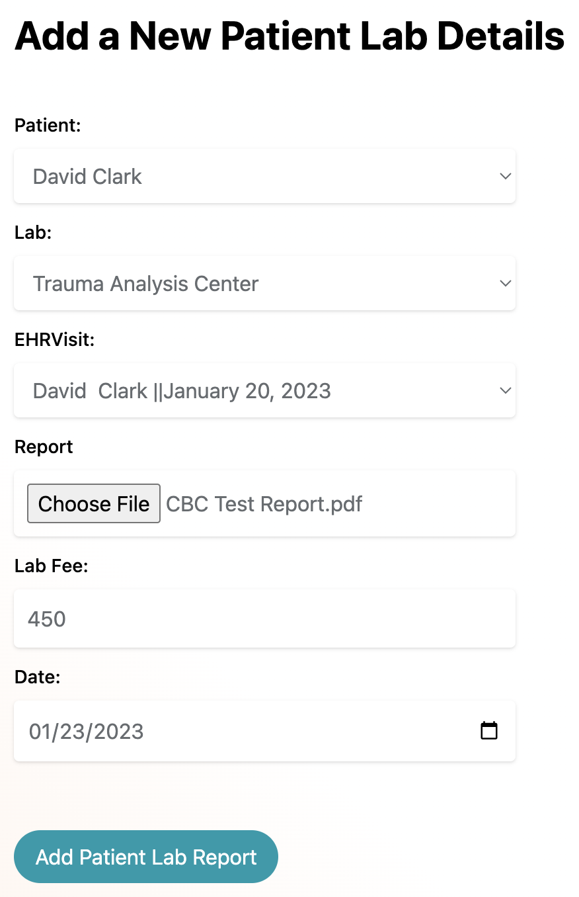
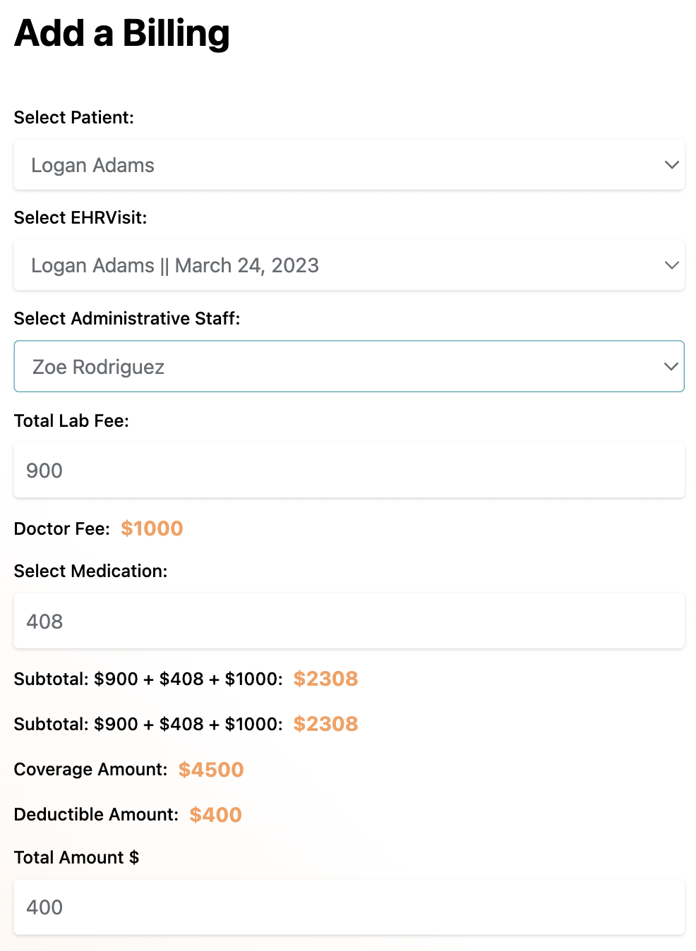
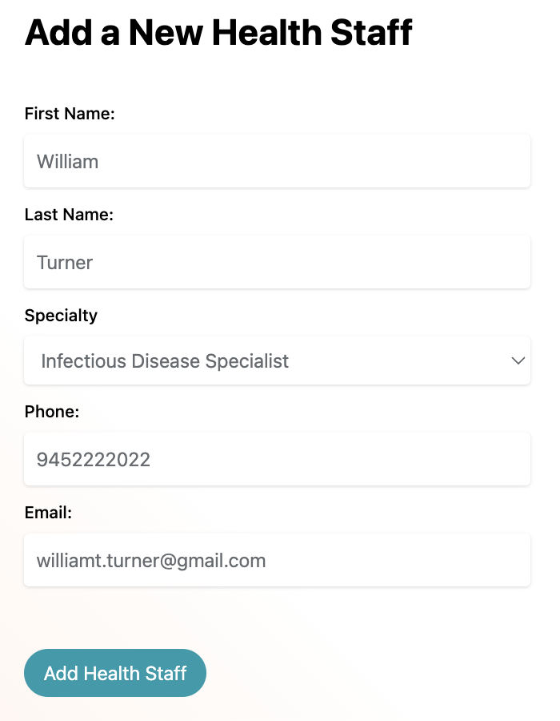
Data Entry

Slide 18
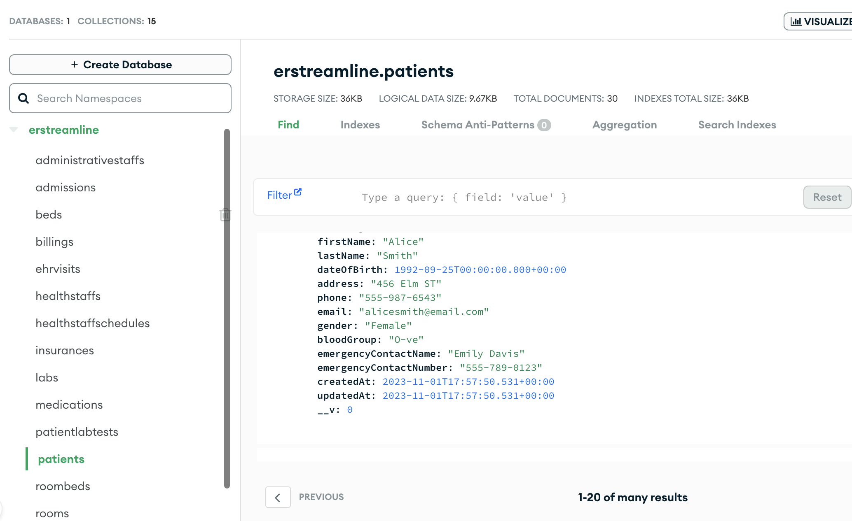
MongoDB

Slide 19
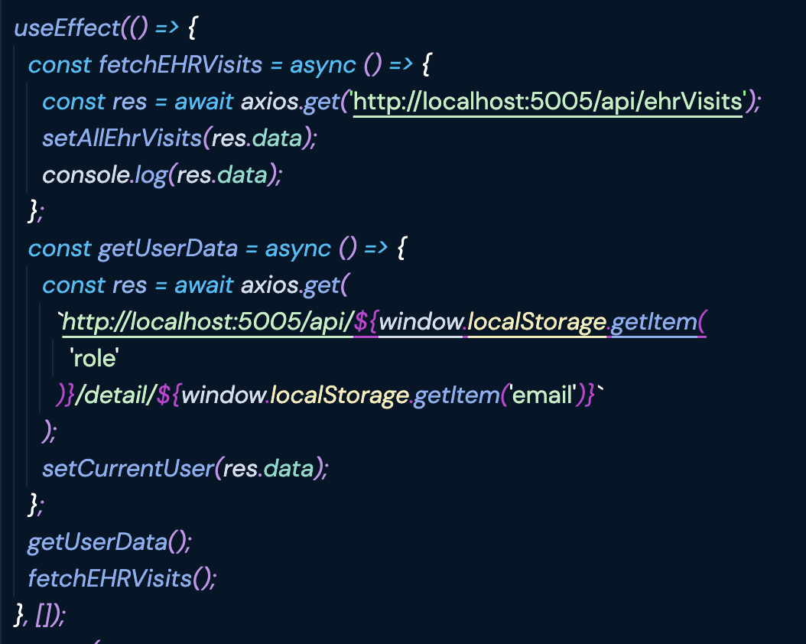
Frontend Implementation
Created various component like Health Staff, Admin Staff, and implemented CRUD operation on them.
Role based authentication
Fetched API using Axios

Slide 20
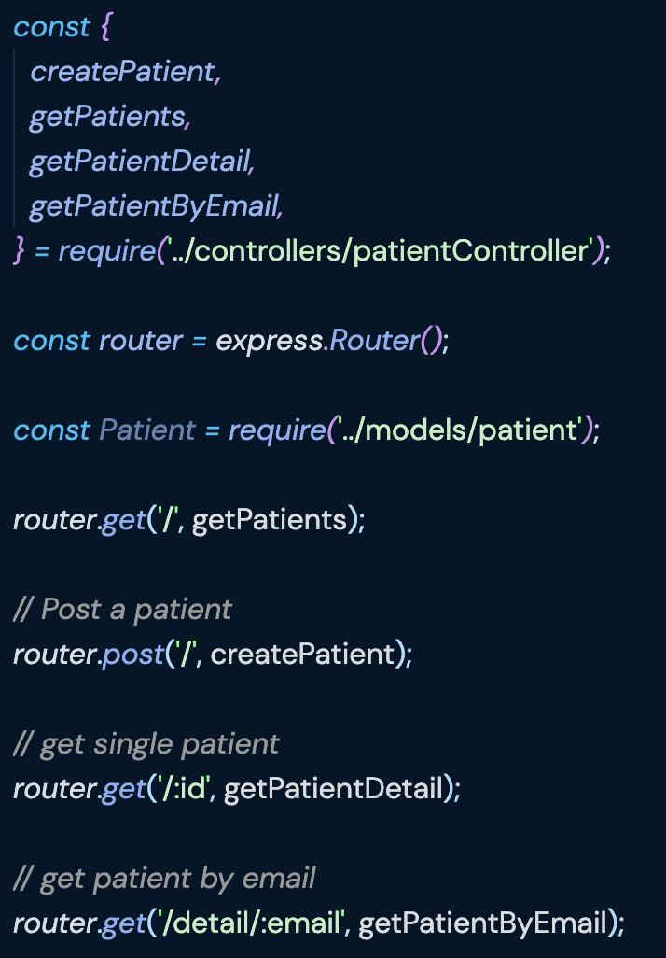
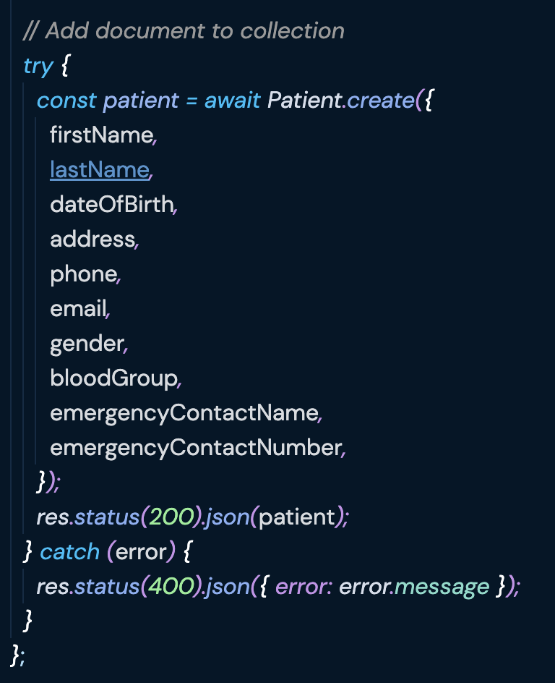
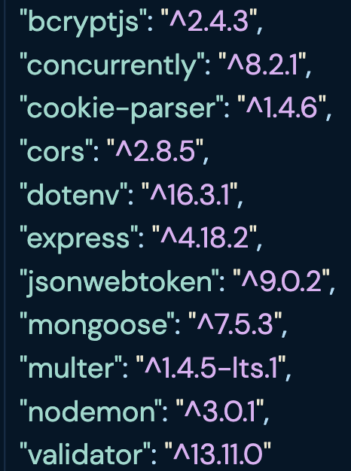
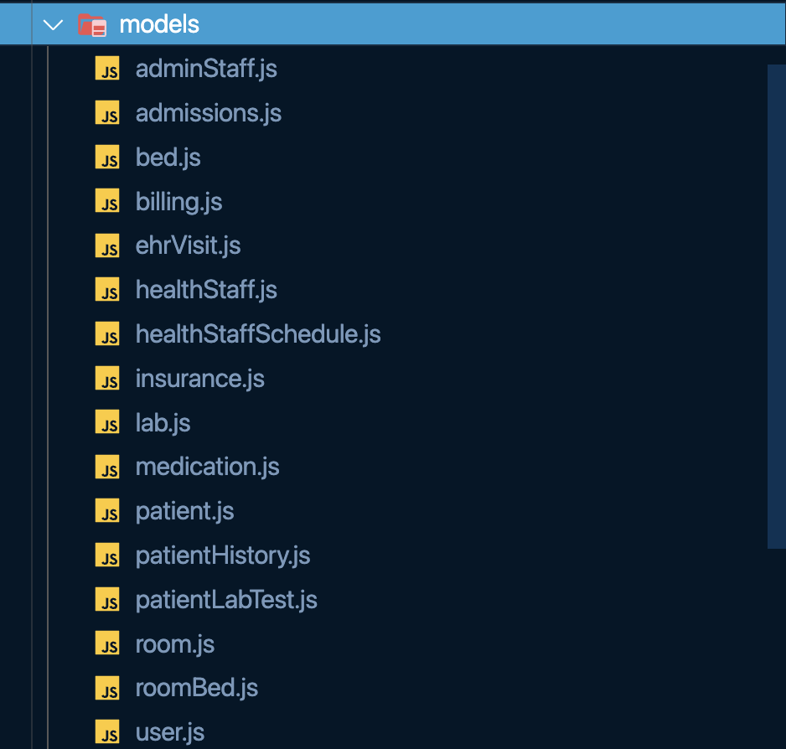
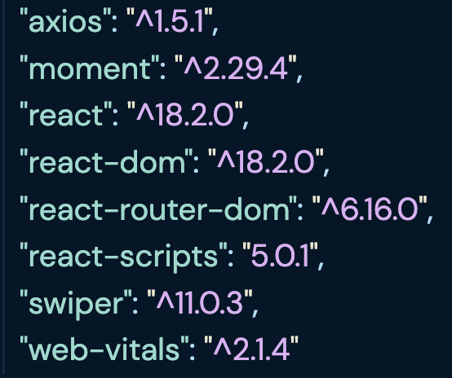
Backend Implementation
Model
Routes
Middleware
Controllers

Slide 21
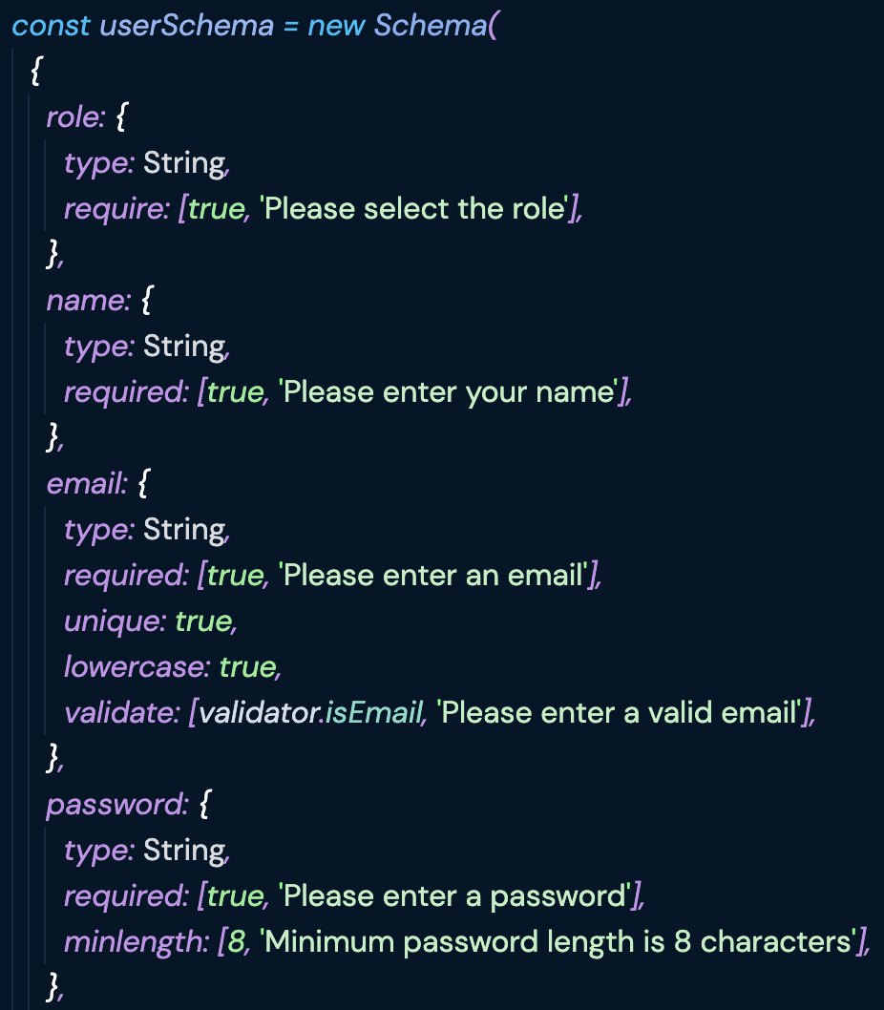
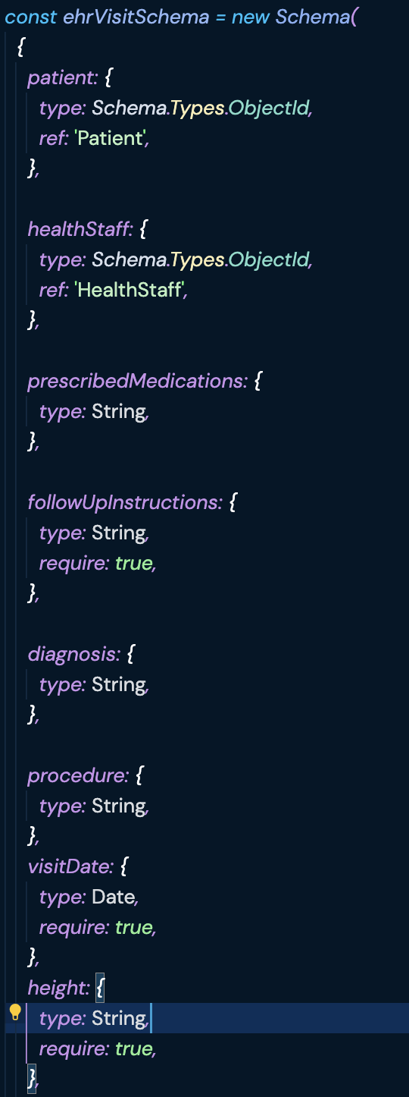
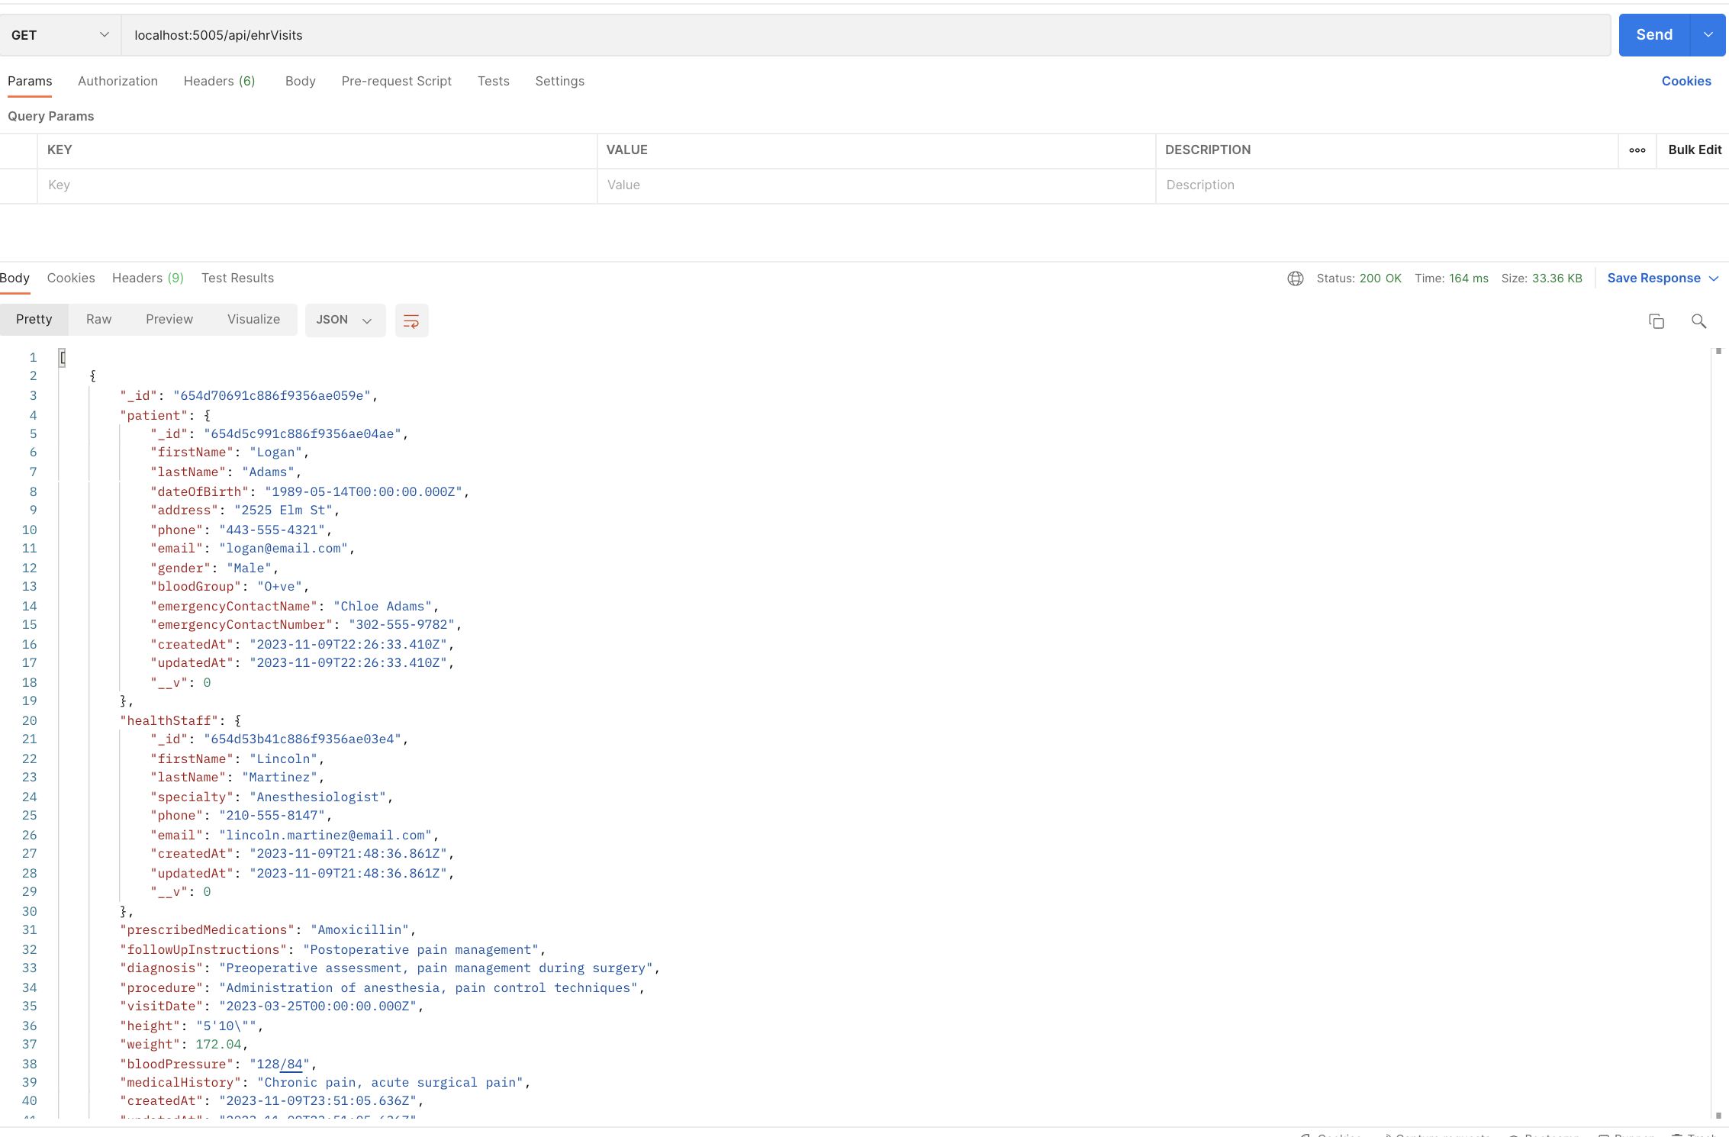
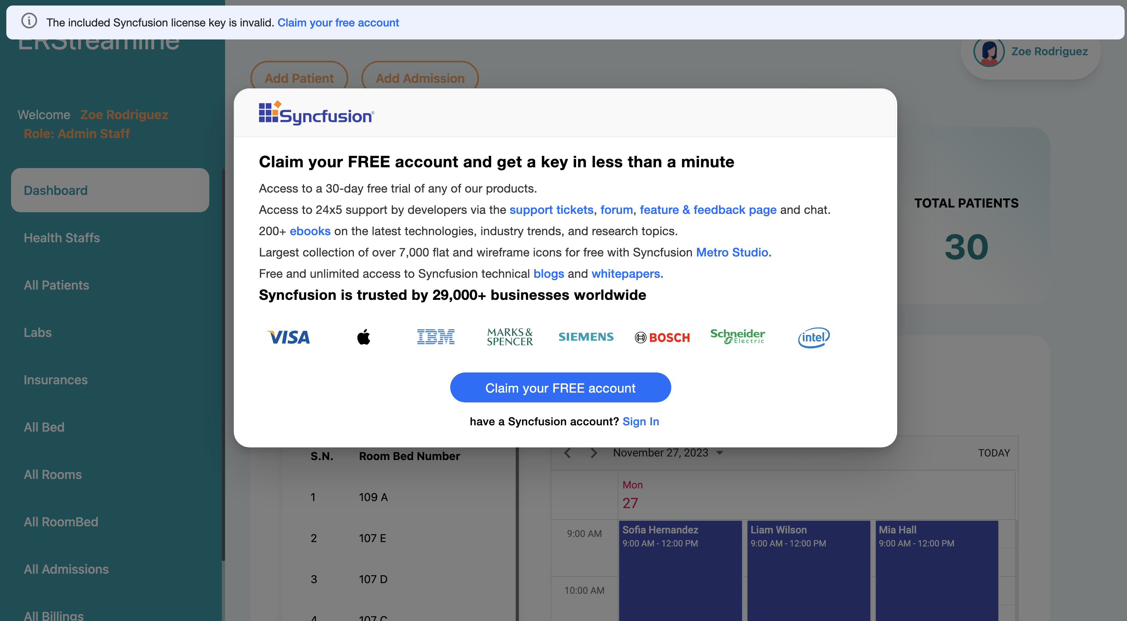
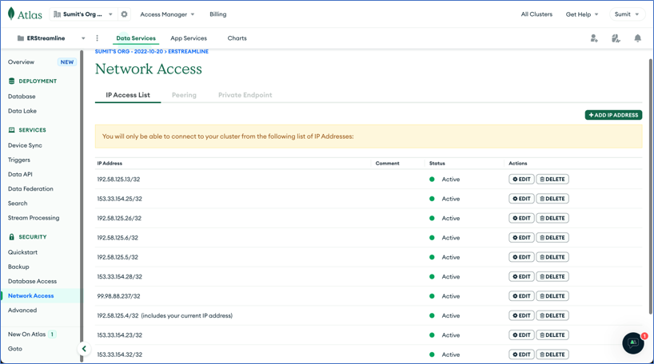
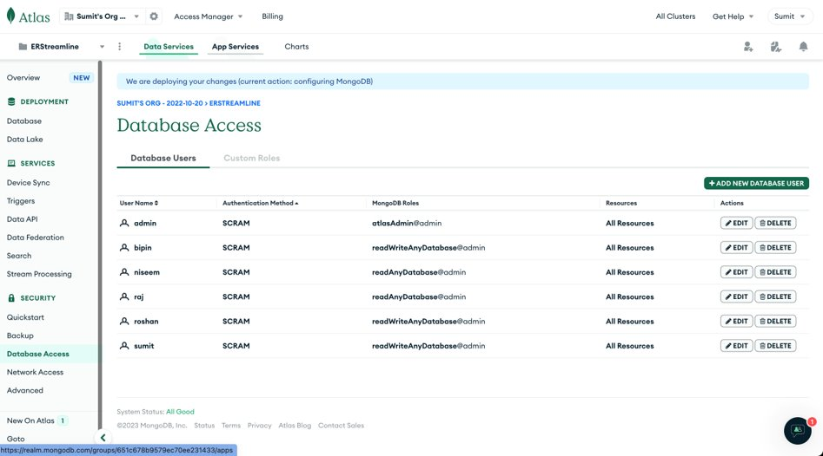
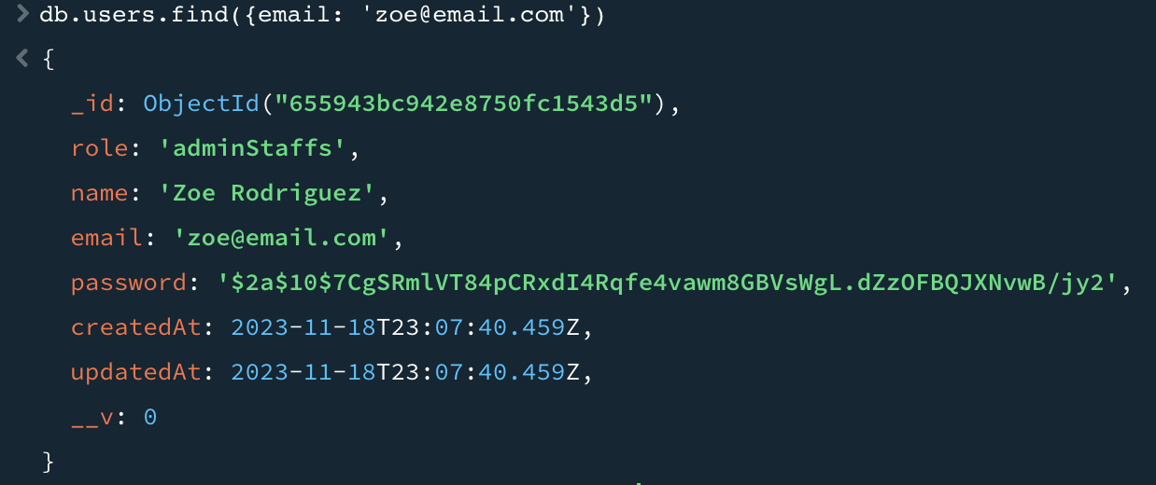

Slide 22
Demo

Slide 23
Conclusion
An Emergency room management system was developed which streamlines its daily operation.
Facilitates Health Staff, Patient and Admin Staff.

Slide 24
Future Work
Whole hospital can be facilitated (Extended interoperation between different departments).
Accountability under healthcare standards like HIPAA.
Can be scaled to build a digitized healthcare ecosystem.

Slide 25
Thank You

